Slide 1
Busitema
University
Pursuing excellence
Faculty of Engineering and Technology
Group 17
MATLAB Group Assignment

Slide 2
Busitema
University
Pursuing excellence
Group 17 Members
Name | Reg Number | Program
AHAISIBWE CHRISTOPHER | BU/UP/2024/0824 | AMI
GIFT EMMANUEL | BU/X/2024/3250 | WAR
ADWONG CALEB | BU/UP/2024/3813 | MEB
MUWUBYA WYCLIFFE | BU/UP/2024/1045 | WAR
OWINO POSH | BU/UP/2024/1067 | WAR
ATATI EDWINE | BU/UP/2024/3730 | AMI
NABUKEERA ANNET RIONAH | BU/UG/2024/2676 | AMI
AHEREZA FAITH | BU/UG/2024/2673 | APE
OPOKA VINCENT | BU/UG/2024/2675 | AMI
AKELLO BARBRA | BU/UP/2024/1001 | WAR

Slide 3

Question 1.1
Question 1.2
Retrieve a unique data set from kaggle.com in Excel format.
Write a single MATLAB script to:
From question 1.1 , utilize all knowledge from module 1 to 4 to visualize the different parameter, patterns, trends and relationships
1. Read the dataset into MATLAB
2. Copy variables for each year
Ensure each plot is saved as an image and it’s well annotated
3. Display data for each year in separate tables
4. Convert the tables from (3) into structural arrays
5. Output the variables from the structural arrays into one Excel workbook and separate sheets for data of each year with clear column headings
Group 17

Slide 4




Question 1.1
Retrieve a unique data set from kaggle.com in Excel format.
Retrieve a dataset from kaggle.com in Excel format
Indian_water_data.csv
1. Read the dataset into MATLAB
Group 17

Slide 5
Question 1.1
1. Read the dataset into MATLAB
% Input file path
kaggle_data_file = "C:\Users\EDDY\Documents\sub\Indian_water_data.xlsx";
Table = readtable(kaggle_data_file);
Here we setup the files we will utilize by declaring their paths in the local computer where our MATLAB environment is installed
2. Copy variables for each year
Group 17

Slide 6
Question 1.1
2. Copy variables for each year
% Tables of each year of data
T_2022 = Table(Table.Year == 2022, :);
T_2023 = Table(Table.Year == 2023, :);
3. Display data for each year in separate tables
Group 17

Slide 7
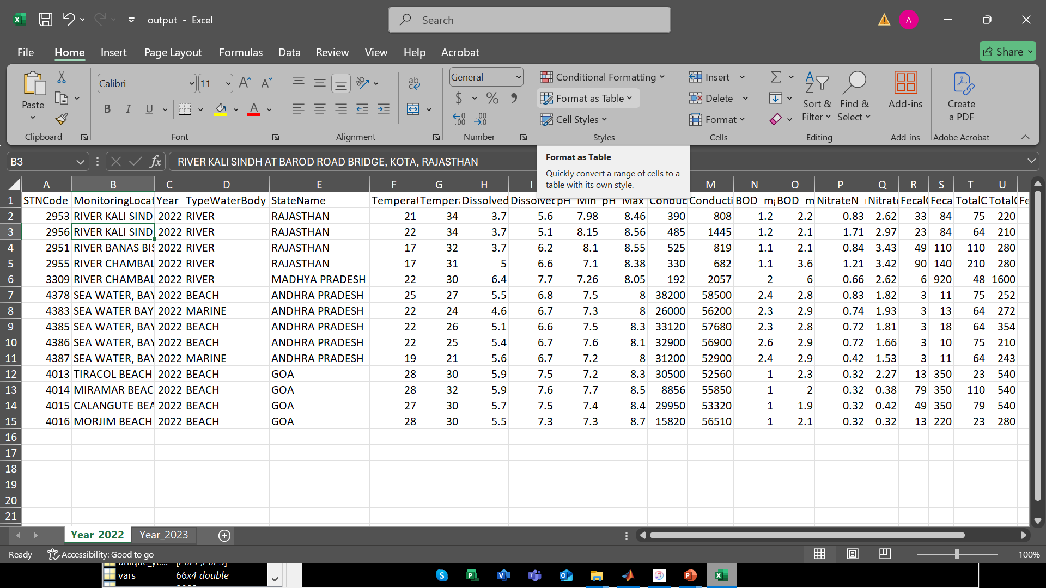
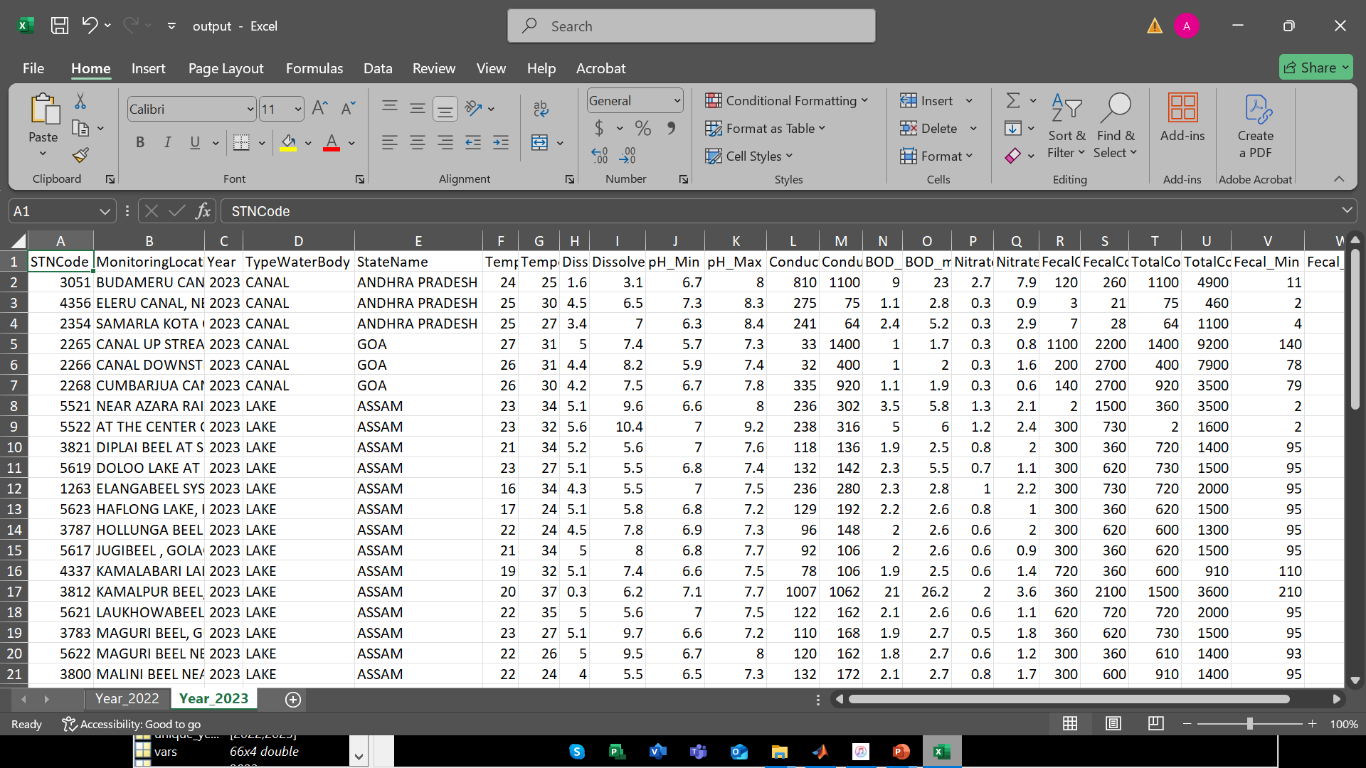
Question 1.1
3. Display data for each year in separate tables
2022
2023
Group 17
4. Convert the tables from (3) into structural arrays

Slide 8
Question 1.1
4. Convert the tables from (3) into structural arrays
This block of code runs the loop that performs the core operation
For each year; it runs through the dataset and picks out rows that have that year, saves them to a new filtered table, converts the table to a structural array and puts the array into a sheet in Excel
Until all years are done through!
% Process data for each year in to structural arrays
struct_arrays = struct();
unique_years = unique(Table.Year);
for i = 1:length(unique_years)
year = unique_years(i);
year_data = Table(Table.Year == year, :);
currentYear = sprintf('Year_%d', year);
% Store data in struct and Excel
S = table2struct(year_data);
struct_arrays(i).(currentYear) = S;
writetable(year_data,"output.xlsx",'Sheet',currentYear);
end
Group 17
5. Output the variables from the structural arrays into one Excel workbook ……

Slide 9
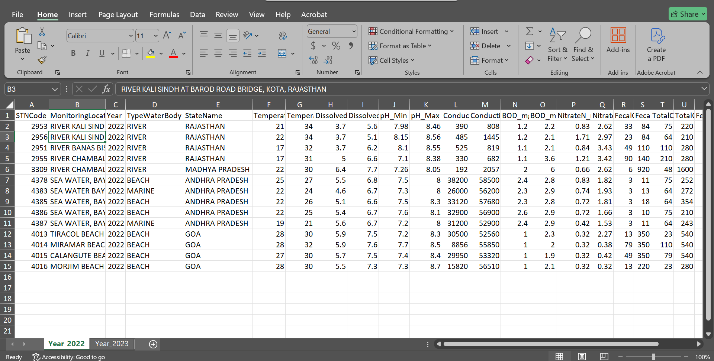
Question 1.1
5. Output the variables from the structural arrays into one Excel workbook and separate sheets for data of each year with clear column headings
Output results
Question 1.2
Group 17

Slide 10
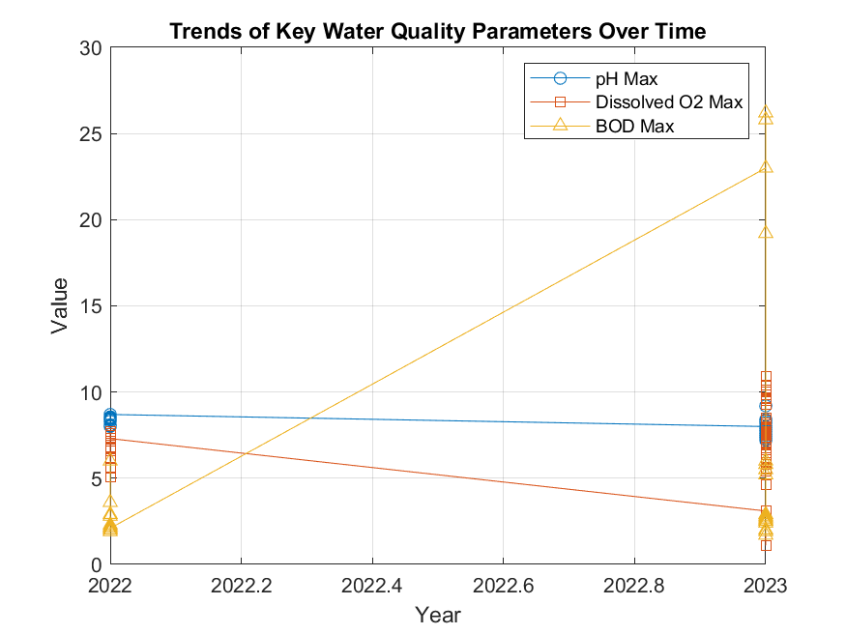
Question 1.2
Visualizing the different parameter, patterns, trends and relationships and ensuring each plot is saved as an image and it’s well annotated
Line Plot
Bar chart
% Line plot: Year vs pH, Dissolved Oxygen, BOD
figure;
plot(Table.Year, Table{:,'pH_Max'}, '-o'); hold on;
plot(Table.Year, Table{:,'Dissolved_Max'}, '-s');
plot(Table.Year, Table{:,'BOD_mg_L__Max'}, '-^');
xlabel('Year'); ylabel('Value');
legend('pH Max','Dissolved O2 Max','BOD Max');
title('Trends of Key Water Quality Parameters Over Time');
grid on;
saveas(gcf,'Line_plot.png');
Group 17

Slide 11
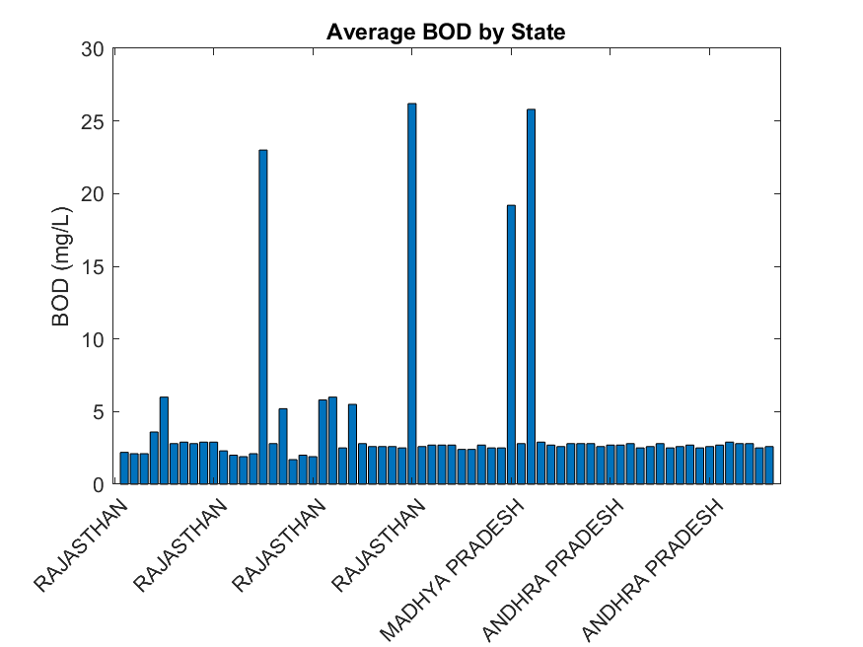
Question 1.2
Visualizing the different parameter, patterns, trends and relationships and ensuring each plot is saved as an image and it’s well annotated
Line Plot
Bar chart
Histogram
% Bar chart
figure;
avgState = Table.BOD_mg_L__Max;
bar(avgState);
xticklabels(Table.StateName); ylabel('BOD (mg/L)');
title('Average BOD by State');
xtickangle(45);
saveas(gcf,'Bar_chart.png');
Group 17

Slide 12
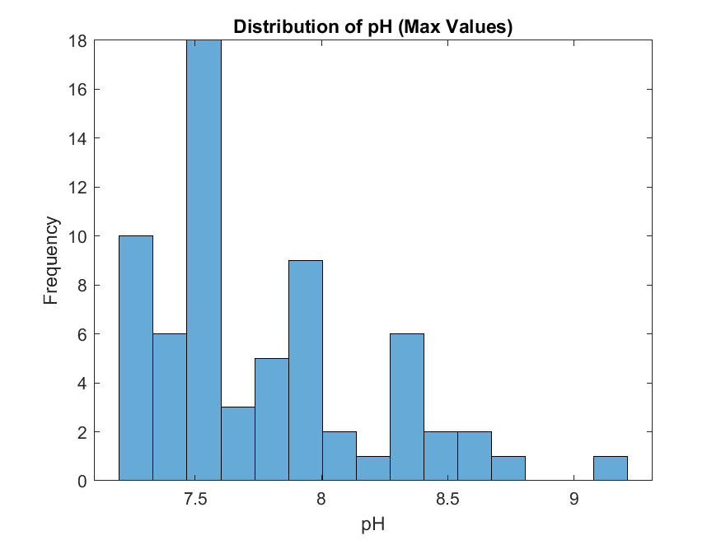
Question 1.2
Visualizing the different parameter, patterns, trends and relationships and ensuring each plot is saved as an image and it’s well annotated
Line Plot
Bar chart
Histogram
Scatter plot
% Histogram of pH values
figure;
histogram(Table.("pH_Max"), 15);
xlabel('pH'); ylabel('Frequency');
title('Distribution of pH (Max Values)');
saveas(gcf,'Histogram.png');
Group 17

Slide 13
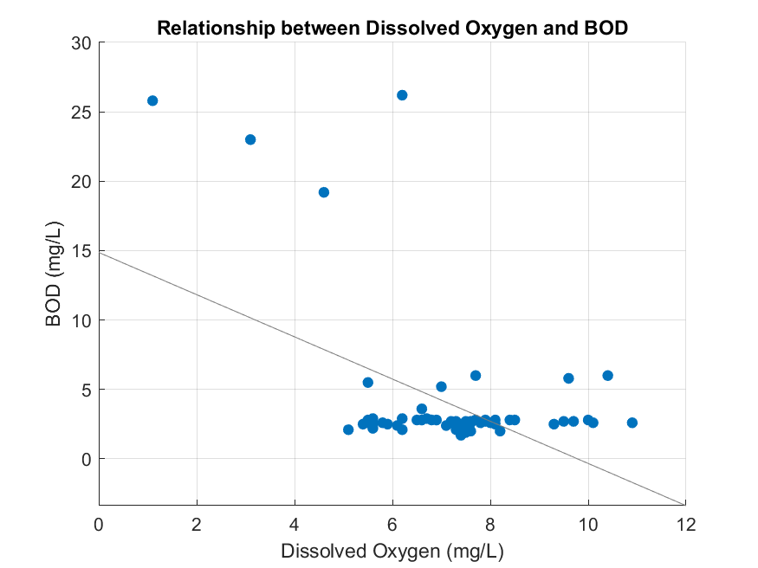
Question 1.2
Visualizing the different parameter, patterns, trends and relationships and ensuring each plot is saved as an image and it’s well annotated
Line Plot
Bar chart
Histogram
Scatter plot
Pie chart
% Scatter plot Dissolved O2 vs BOD
figure;
scatter(Table.("Dissolved_Max"), Table.("BOD_mg_L__Max"), 'filled');
xlabel('Dissolved Oxygen (mg/L)');
ylabel('BOD (mg/L)');
title('Relationship between Dissolved Oxygen and BOD');
grid on;
lsline; % add regression line
saveas(gcf,'Scatter_plot.png');
Group 17

Slide 14
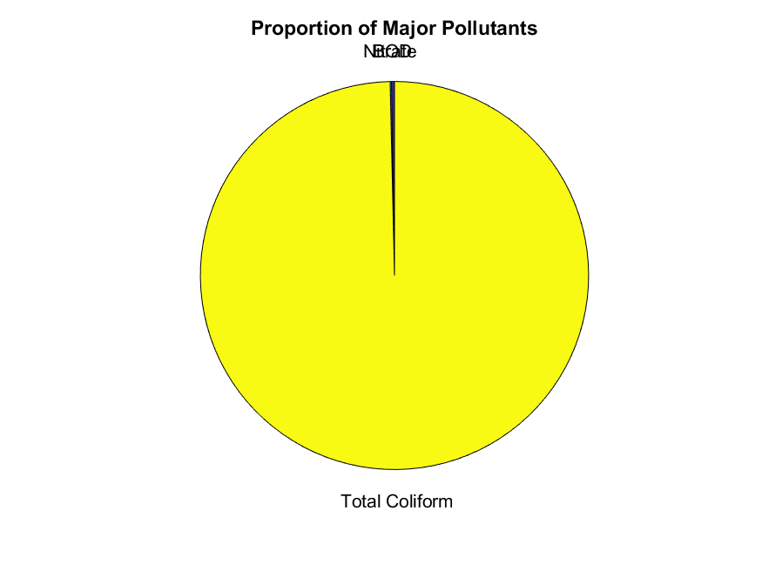
Question 1.2
Visualizing the different parameter, patterns, trends and relationships and ensuring each plot is saved as an image and it’s well annotated
Line Plot
Bar chart
Histogram
Scatter plot
Pie chart
Heat map
% Mean values of pollutants
pollutants = [mean(Table.("BOD_mg_L__Max"),'omitnan'), ...
mean(Table.("NitrateN_mg_L__Max"),'omitnan'), ...
mean(Table.("TotalColiform_MPN_100ml__Max"),'omitnan')];
labels = {'BOD','Nitrate','Total Coliform'};
figure;
pie(pollutants, labels);
title('Proportion of Major Pollutants');
saveas(gcf,'Pie_chart.png');
Group 17

Slide 15
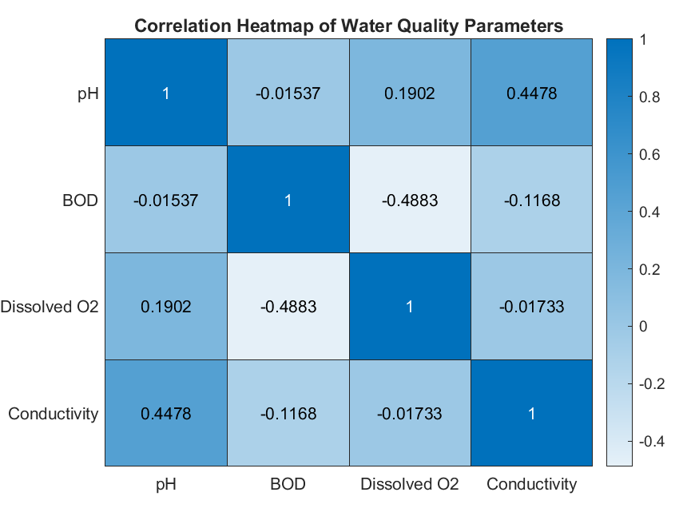
Question 1.2
Visualizing the different parameter, patterns, trends and relationships and ensuring each plot is saved as an image and it’s well annotated
Line Plot
Bar chart
Histogram
Scatter plot
Pie chart
Heat map
3D plot
% Correlation matrix
vars = Table{:, {'pH_Max','BOD_mg_L__Max','Dissolved_Max','Conductivity___mho_cm__Max'}}; % Select reliable numeric variables
corrMatrix = corr(vars, 'Rows','complete');
figure;
heatmap({'pH','BOD','Dissolved O2','Conductivity'}, ...
{'pH','BOD','Dissolved O2','Conductivity'}, ...
corrMatrix);
title('Correlation Heatmap of Water Quality Parameters');
saveas(gcf,'Heat_map.png');
Group 17

Slide 16
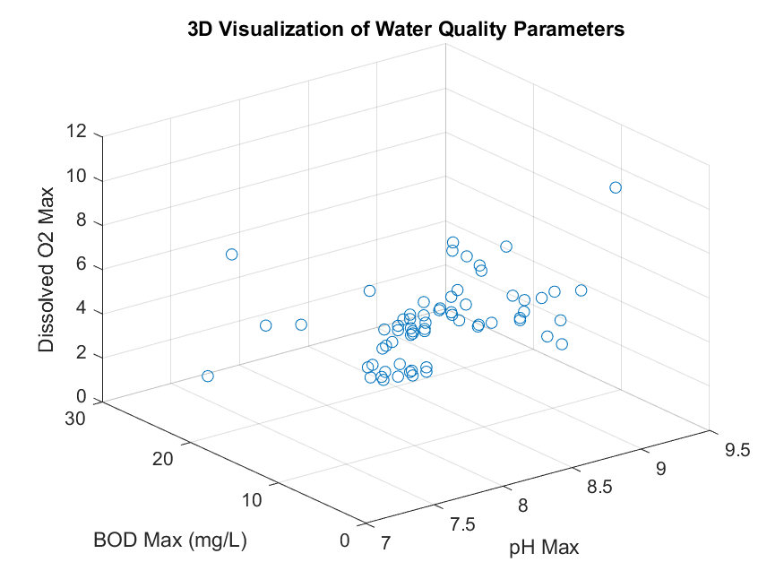
Question 1.2
Visualizing the different parameter, patterns, trends and relationships and ensuring each plot is saved as an image and it’s well annotated
Line Plot
Bar chart
Histogram
Scatter plot
Pie chart
Heat map
3D plot
% 3D visualization of water quality parameters
figure;
plot3(Table.("pH_Max"), Table.("BOD_mg_L__Max"), Table.("Dissolved_Max"), 'o');
xlabel('pH Max'); ylabel('BOD Max (mg/L)'); zlabel('Dissolved O2 Max');
title('3D Visualization of Water Quality Parameters');
grid on;
saveas(gcf,'3D_Visualization.png');
Question 2.1
Group 17

Slide 17
Question 2.1
Question 2.2
Each group has different members from different backgrounds, home districts , religions , tribes , villages, courses , interests, ages, names and facial representations.
Write a MATLAB code that can store each members attributes into a single variable. Ensure the code saves the value.
From question 2.1 , utilize all knowledge from module 1 to 4 to describe the different statistical characteristics in the data and ensure to visualize them. Ensure that the different attributes or data collected per individual is detailed enough to describe them.
Group 17

Slide 18
Question 2.1
fprintf('\n=== GROUP 17 MEMBERS ATTRIBUTES ===\n');
% Each group members attributes stored and saved into a single variable
NAME = ["Babra";"wycliff";"Gift";"Chris";"Vincent";"Caleb";"Edwine";"Faith";"Rhionah";"Posh"];
AGE = [20;25;31;23;22;34;26;21;19;28];
TRIBE = ["Atesot";"Musoga";"Kakwa";"Muganda";"Kejong";"Jap";"Mutoro";"Mukiga";"Munyoro";"Samia"];
HOME_DISTRICT = ["Amuria";"Kamuli";"Serori";"Mukono";"Moroto";"Tororo";"Kagadi";"Kabale";"Hoima";"Busia"];
VILLAGE = ["Acowa";"Achai";"Timo";"Mbalala";"Akwak";"Nagongera";"Busesa";"Kayoli";"Kiriatete";"Shaule"];
RELIGION = ["Catholic";"Pentecostal";"Anglican";"Catholic";"Catholic";"Anglican";"Muslim";"Anglican";"Catholic";"SDA"]
COURSE = ["WAR";"WAR";"WAR";"AMI";"AMI";"MEB";"AMI";"APE";"AMI";"WAR"];
INTEREST = ["Reading";"Praying";"Research";"Reading";"Football";"Bako";"Praying";"Swimming";"Dancing";"Bako"];
FACIAL_REPRESENTATION = ["brown"; "dark brown"; "dark"; "dark brown"; "fair dark"; "fair dark"; "optimum brown"; "fair brown"; "brown" ; "fair brown";];
TABLE = table(NAME,AGE,TRIBE,HOME_DISTRICT,VILLAGE,RELIGION,COURSE,INTEREST,FACIAL_REPRESENTATION);
disp(TABLE); % displays table
writetable(TABLE,'Group 17 member attributes.xlsx'); %creates an excel workbook to save the attributes
In these lines of code, we create an array of each attribute containing all the members’ details. The code also creates and saves the different attributes a variable in a table.
Group 17

Slide 19
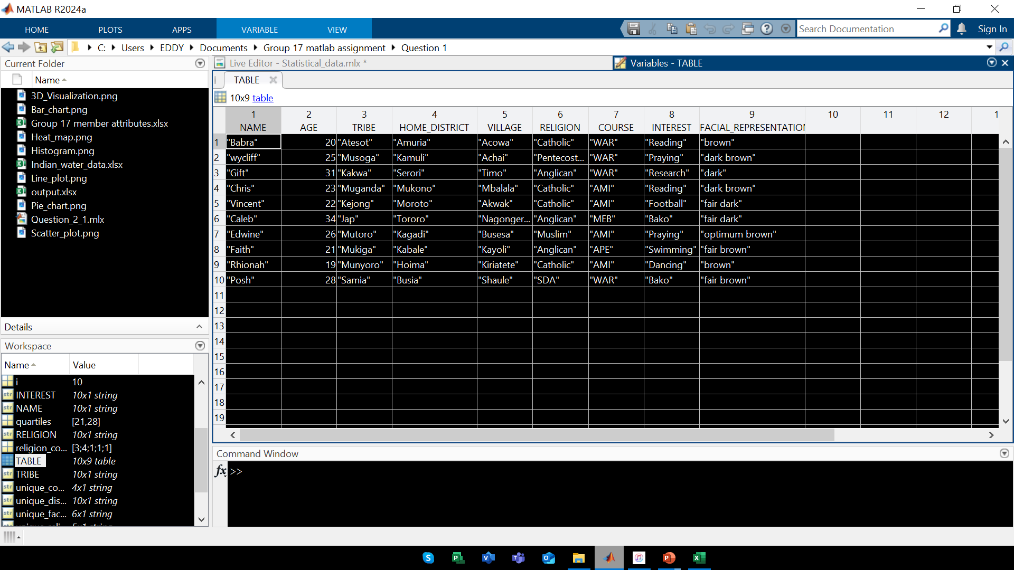
Question 2.1
Results
Question 2.2
Group 17

Slide 20
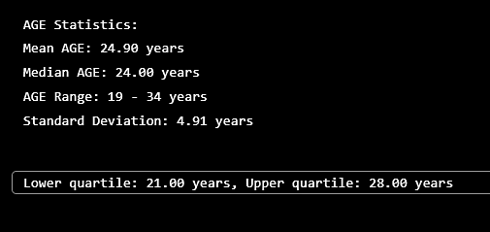
Question 2.2
distribution
Statistical characteristics
% Age Statistics
fprintf('AGE Statistics: '); %Displays age statistics
fprintf('Mean AGE: %.2f years', mean(AGE)); %calculating the mean age of 10members and fixes it to 2 decimal places
fprintf('Median AGE: %.2f years', median(AGE)); %calculates the median age of 10members and fixes it 2 decimal places
fprintf('AGE Range: %d - %d years', min(AGE), max(AGE)); %minimum and maximum age
fprintf('Standard Deviation: %.2f years', std(AGE)); %standard deviation of the ages
%Upper and lower quartiles
quartiles = quantile(AGE, [0.25, 0.75]);
fprintf('Lower quartile: %.2f years, Upper quartile: %.2f years', quartiles(1), quartiles(2));
Group 17

Slide 21
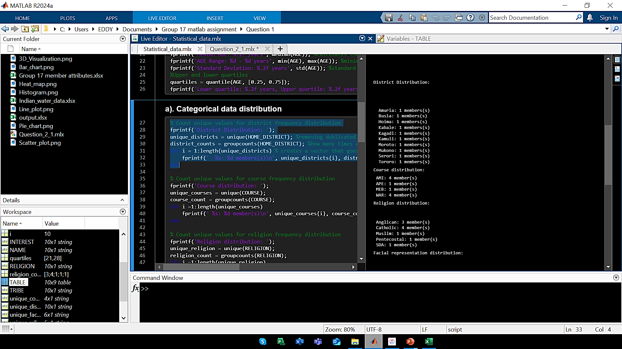
Question 2.2
distribution
Statistical characteristics
% Count unique values for district frequency distribution
fprintf('District Distribution: ');
unique_districts = unique(HOME_DISTRICT); %removing dublicated values leaving only unique elements
district_counts = groupcounts(HOME_DISTRICT); %how many times a unique value appears in the data
for i = 1:length(unique_districts) % creates a vector that goes from 1 to the length of unique districts
fprintf(' %s: %d members(s)\n', unique_districts{i}, district_counts(i)); % Prints out unique district with the end number of members in each district
Group 17

Slide 22
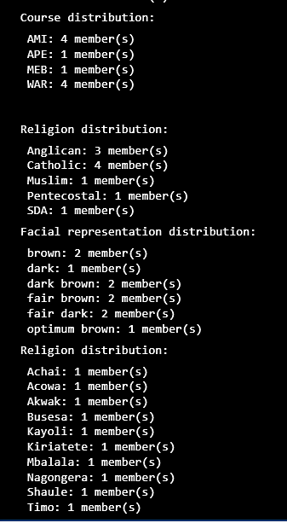
Question 2.2
distribution
Statistical characteristics
% Count unique values for course frequency distribution
fprintf('Course distribution: ');
unique_courses = unique(COURSE);
course_count = groupcounts(COURSE);
for i =1:length(unique_courses)
printf(' %s: %d member(s)\n', unique_courses{i}, course_count(i));
end
% Count unique values for religion frequency distribution
fprintf('Religion distribution: ');
unique_religion = unique(RELIGION);
religion_count = groupcounts(RELIGION);
for i =1:length(unique_religion)
fprintf(' %s: %d member(s)\n', unique_religion{i}, religion_count(i));
end
% Count unique values for facial representation frequency distribution
fprintf('Facial representation distribution: ');
unique_facial_rep = unique(FACIAL_REPRESENTATION);
facial_rep_count = groupcounts(FACIAL_REPRESENTATION);
for i =1:length(unique_facial_rep)
fprintf(' %s: %d member(s)\n', unique_facial_rep{i}, facial_rep_count(i));
end
% Count unique values for village frequency distribution
fprintf('Religion distribution: ');
unique_village = unique(VILLAGE);
village_count = groupcounts(VILLAGE);
for i =1:length(unique_village)
fprintf(' %s: %d member(s)\n', unique_village{i}, village_count(i));
end
Group 17

Slide 23
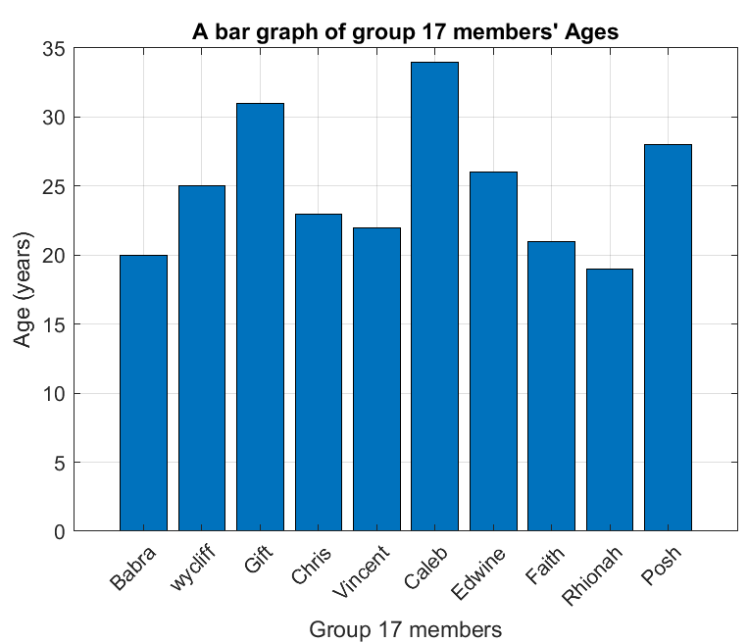
Question 2.2
2D bar graph
3D bar plot
Statistical characteristics
Visualization and plotting
%2D bar graph for members' ages
figure; %creates new graphical window for plotting
bar(AGE);
title("A bar graph of group 17 members' Ages");
xlabel('Group 17 members');
ylabel('Age (years)');
xticklabels(NAME); %labels the horizotal axis with the name variables
xtickangle(45); %angle for the horizotal axis name variables
grid on; % enables gridlines for easy visibility
saveas(gcf,'2D_bar_graph.png'); %saves the bar graph as an image in png format
Group 17

Slide 24
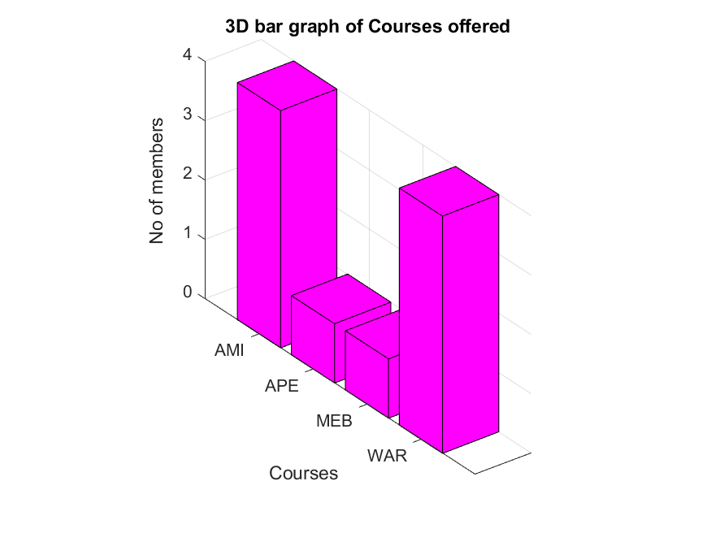
Question 2.2
2D bar graph
3D bar plot
2D pie chart
Statistical characteristics
Visualization and plotting
%3D bar plots
figure;
bar3(course_count, 'magenta');
title('3D bar graph of Courses offered');
zlabel('No_ of members');
yticklabels(unique_courses);
ylabel("Courses");
grid on;
saveas(gcf,'3D_bar_graph.png');
Group 17

Slide 25
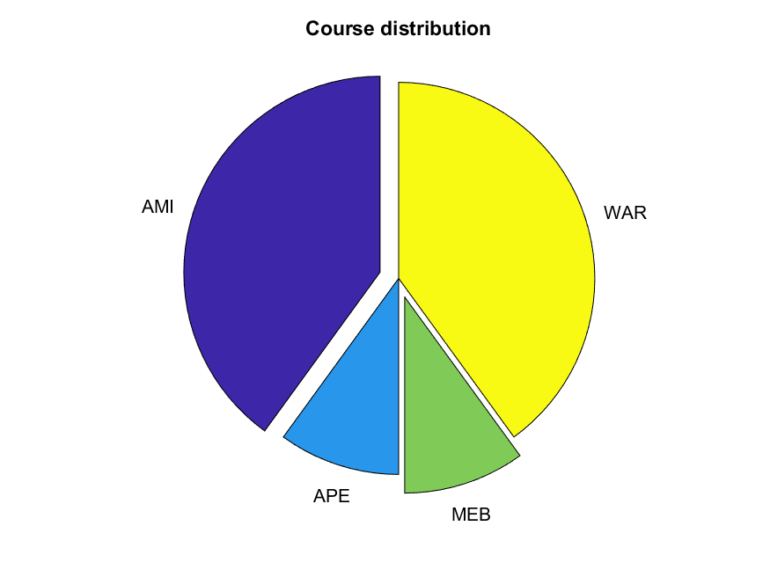
Question 2.2
2D bar graph
3D bar plot
2D pie chart
3D pie chart
Statistical characteristics
Visualization and plotting
% 2D Exploded pie chart
figure;
exploded = [2,0,1,0]; %pulls AMI and MEB
pie(course_count, exploded,unique_courses);
title('Course distribution');
saveas(gcf,'2Dpie_chart.png');
Group 17

Slide 26
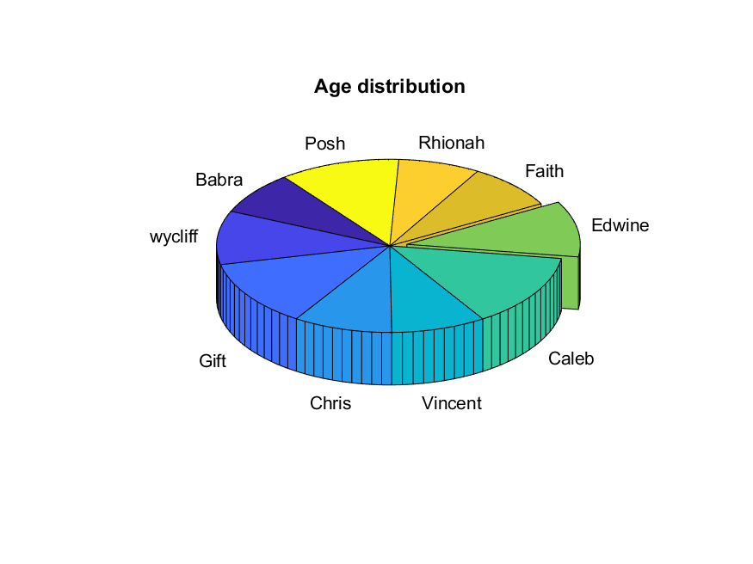
Question 2.2
2D bar graph
3D bar plot
2D pie chart
3D pie chart
Fill plot
Statistical characteristics
Visualization and plotting
% 3D exploded pie chart
figure;
expld = [0,0,0,0,0,0,1,0,0,0];
pie3(AGE,expld,NAME);
title('Age distribution');
saveas(gcf,'3Dpie_chart.png');
Group 17

Slide 27
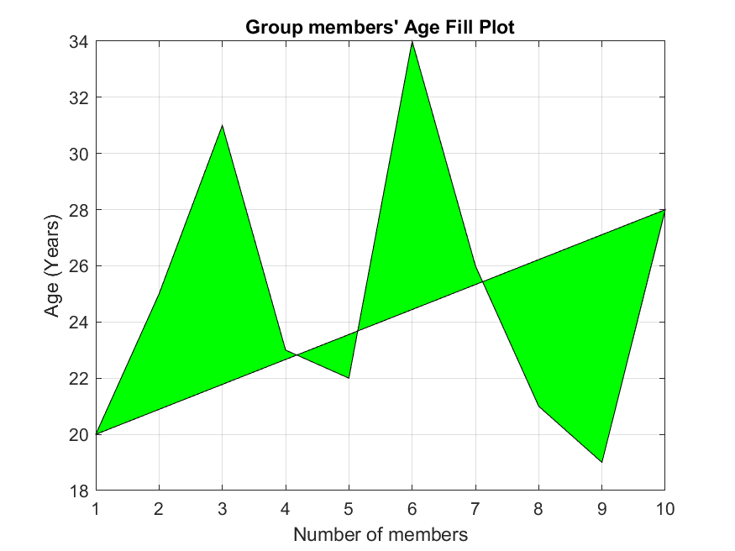
Question 2.2
2D bar graph
3D bar plot
2D pie chart
3D pie chart
Fill plot
Step response
Statistical characteristics
Visualization and plotting
%fill plot
figure;
fill(1:10, AGE, 'g'); %fills up the area inside the plot with green
title("Group members' Age Fill Plot");
ylabel('Age (Years)');
xlabel('Number of members');
grid on;
saveas(gcf,'fill_plot.png');
Group 17

Slide 28
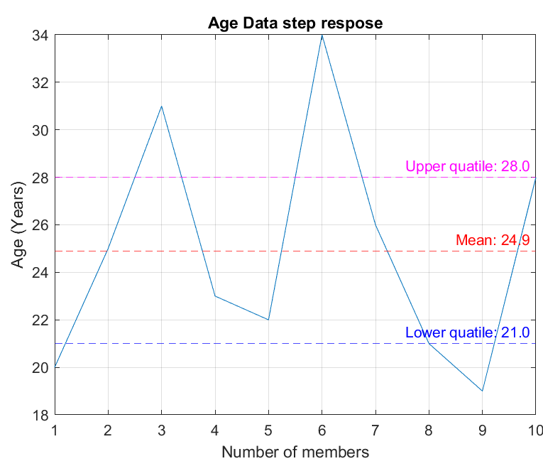
Question 2.2
2D bar graph
3D bar plot
2D pie chart
3D pie chart
Fill plot
Step response plot
Polar histogram
Statistical characteristics
Visualization and plotting
%Step respose plot
figure;
plot(AGE);
yline(mean(AGE), 'r--', sprintf('Mean: %.1f',mean(AGE))); %draws a red dotted line showing the mean age
yline(quartiles(1), 'b--', sprintf('Lower quatile: %.1f',quartiles(1))); %draws a blue dotted line showing the the lower quatile
yline(quartiles(2), 'm--', sprintf('Upper quatile: %.1f',quartiles(2))); %draws a magenta dotted line showing the upper quatile
title('Age Data step respose');
xlabel('Number of members');
ylabel('Age (Years)')
grid on;
saveas(gcf,'Step_respose_plot.png');
Group 17

Slide 29
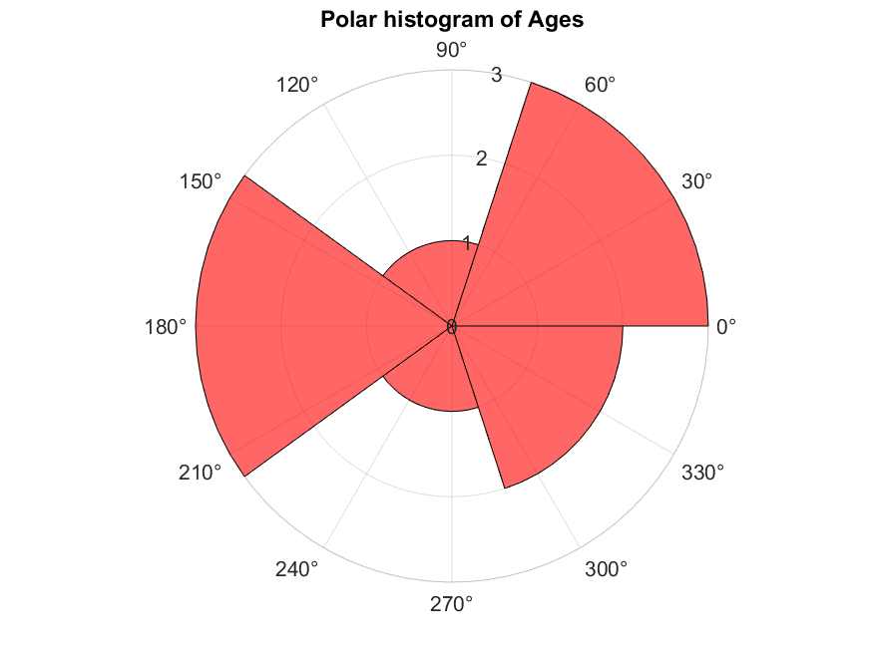
Question 2.2
2D bar graph
3D bar plot
2D pie chart
3D pie chart
Fill plot
Step response plot
Polar histogram
Statistical characteristics
Visualization and plotting
%polar histogram
figure;
polarhistogram(AGE, 5, 'Facecolor','r');
title('Polar histogram of Ages');
saveas(gcf,'polar_histogram.png');
conclusion
Group 17

Slide 30
conclusion
CHALLENGES
Code optimizations issues
Limitation in Understanding complex graphics & algorithms
ACHIEVEMENTS
Success in completing a complex task
Knowledge about data analysis in MATLAB
CONCLUSION
We hope to have a deeper insight on the use of MATLAB
Group 17

Slide 31
Group 17

